Slide 1
1. XML layout – XML container
2. Types of event programming
3. Toast & Alert Dialog
4. Common controls
5. Advanced controls
6. Custom layout
7. Webkit
8. Intent & Intent filters
9. Touch & Multi touch
10. Multi language in Android

Slide 2
1. XML layout – XML container
1.1 Android Layouts
1.2 View class
1.3 Sample UI components
1.4 XML layout and attaching
1.5 UI Hierarchy
1.6 Common layouts

Slide 3
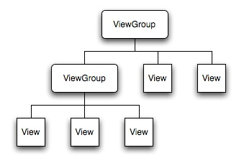
1.1 Android Layouts
Each element in the XML Layout is either a View or ViewGroup object
Displaying the Application‘s View
paints the screen by walking the View tree by asking each component to draw itself in a pre-order traversal way.
Each component draws itself and then asks each of its children to do the same.

Slide 4
1.2 View class
The View class represents the basic building block for user interface components.
a rectangular area on the screen
responsible for drawing and event handling.
is the base class for widgets
The ViewGroup subclass is the base class for layouts
invisible containers that hold other Views
and define inside views layout properties.

Slide 5
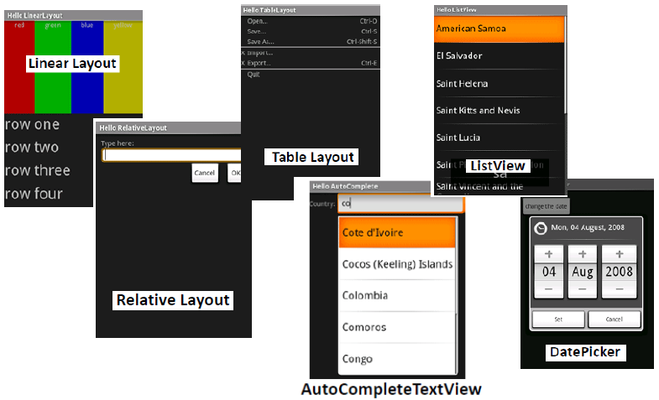
1.3 Sample UI components

Slide 6
1.4 XML layout and attaching
What is an XML layout?
An XML-based layout is a specification of the various UI components (widgets) and the relationships to each other –and to their containers –all written I
Android considers XML-based layouts to be resources, and as such layout files are stored in the res/layout directory inside your Android project XML format.
You could create Layout XML files using UI tools such as:
Eclipse ADT UI Designer (getting better but still…)
DroidDraw (to be phased out soon???)
Asset Studio (probably the best option, not available yet)

Slide 7
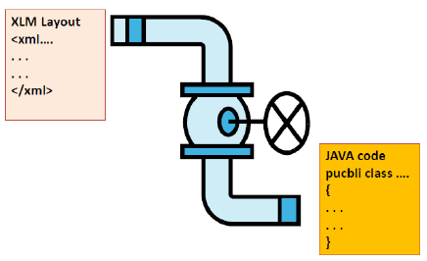
1.4 XML layout and attaching
Attaching Layouts to java code
You must “connect” the XML elements with equivalent objects in your Java activity. This allows you to manipulate the UI with code.
setContentView(R.layout.main);
Demo: Button is content view

Slide 8
1.4 XML layout and attaching
Demo

Slide 9
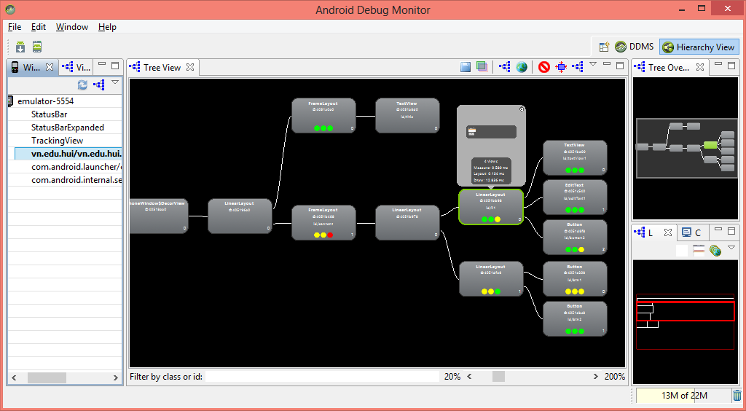
1.5 UI Hierarchy
In SDK folder / Tools/ monitor.bat
HierarchyViewer displays the UI structure of the current screen shown on the emulator or device.

Slide 10
1.6 Common layouts
There are five basic types of Layouts:
Frame, Linear, Relative, Table, and Absolute.
FrameLayout:
simplest type of layout object: a blank space on your screen that you can later fill with a single object
All child elements of the FrameLayout are pinned to the top left corner of the screen; you cannot specify a different location for a child view.
Subsequent child views will simply be drawn over previous ones, partially or totally obscuring them (unless the newer object is transparent).

Slide 11
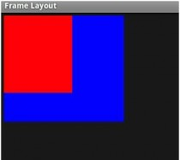
1.6 Common layouts
FrameLayout:
<?xml version="1.0" encoding="utf-8"?>
<FrameLayout android:id="@+id/mainlayout" android:layout_height="fill_parent" android:layout_width="fill_parent" android:orientation="vertical" xmlns:android="http://schemas.android.com/apk/res/android">
<ImageView android:layout_height="wrap_content" android:layout_width="wrap_content" android:padding="5px" android:src="@drawable/blue"/>
<ImageView android:layout_height="wrap_content" android:layout_width="wrap_content" android:padding="5px" android:src="@drawable/red"/>
</FrameLayout>

Slide 12
1.6 Common layouts
LinearLayout:
is a box model –widgets or child containers are lined up in a column or row, one after the next. To configure a LinearLayout, you have five main areas of control besides the container's contents:
orientation,
fill model,
weight,
gravity,
padding ,
margin

Slide 13
1.6 Common layouts
LinearLayout:
aligns all children in a single direction —vertically or horizontally depending on the android:orientation attribute.
All children are stacked one after the other, (vertical list will only have one child per row, a horizontal list will only be one row high - the height of the tallest child, plus padding).
A LinearLayout respects margins between children and the gravity (right, center, or left alignment) of each child.
You may attribute a weight to children of a LinearLayout (wrap_content)

Slide 14
1.6 Common layouts
LinearLayout:
LinearLayout Orientation indicates whether the LinearLayout represents a row or a column.
Add the android:orientation property to your LinearLayout element in your XML layout, setting the value to be horizontal for a row or vertical for a column.
The orientation can be modified at runtime by invoking setOrientation()

Slide 15
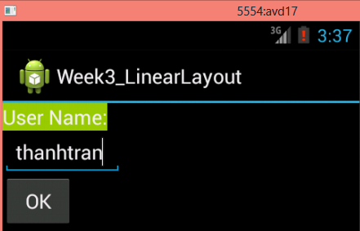
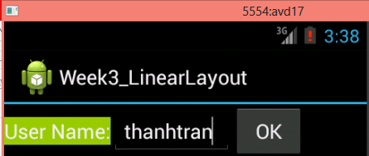
1.6 Common layouts
LinearLayout:
Linear Layout: Orientation indicates whether the LinearLayoutr epresents a row(HORIZONTAL) or a column (VERTICAL).
v
e
r
t
i
c
a
l
Horizontal

Slide 16
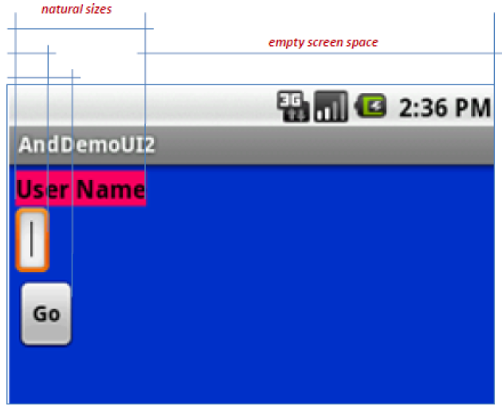
1.6 Common layouts
LinearLayout: Fill Model
Widgets have a "natural" size based on their accompanying text.
When their combined sizes does not exactly match the width of the Android device's screen, we may have the issue of what to do with the remaining space.

Slide 17
1.6 Common layouts
LinearLayout: Fill Model
All widgets inside a LinearLayout must supply dimensional attributes android:layout_width and android:layout_height to help address the issue of empty space. Values used in defining height and width are:
1.Specific a particular dimension, such as 125dip (device independent pixels)
2.Provide wrap_content, which means the widget should fill up its natural space, unless that is too big, in which case Android can use word-wrap as needed to make it fit.
3.Provide fill_parent, which means the widget should fill up all available space in its enclosing container, after all other widgets are taken care of.

Slide 18
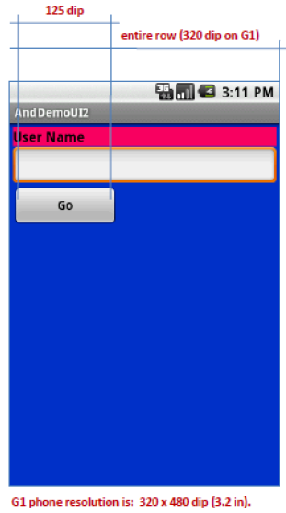
1.6 Common layouts
LinearLayout: Fill Model

Slide 19
1.6 Common layouts
LinearLayout: Weight
It is used to proportionally assign space to widgets in a view.
You set android:layout_weight to a value (1, 2, 3, …) to indicates what proportion of the free space should go to that widget.
Example Both the TextView and the Button widgets have been set as in the previous example. Both have the additional property android:layout_weight="1" whereas the EditTextcontrol has android:layout_weight="2"
Default value is 0

Slide 20
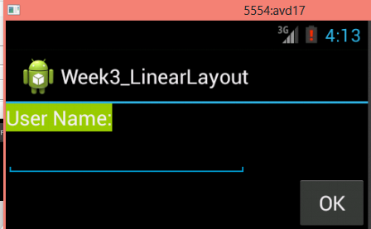
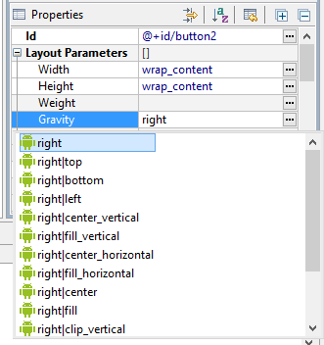
1.6 Common layouts
LinearLayout: Gravity
It is used to indicate how a control will align on the screen.
By default, widgets are left-and top-aligned.
You may use the XML property android:layout_gravity=“…” to set other possible arrangements: left, center, right, top, bottom, etc.

Slide 21
1.6 Common layouts
LinearLayout: Gravity
CAUTION: gravity vs layout_gravity
The difference between:
android:gravity specifies how to place the content of an object, both on the x-and y-axis, within the object itself.
android:layout_gravity positions the view with respect to its parent (i.e. what the view is contained in).

Slide 22
1.6 Common layouts
LinearLayout: Padding
The padding specifies how much space there is between the boundaries of the widget's "cell" and the actual widget contents.
If you want to increase the internal whitespace between the edges of the and its contents, you will want to use the:
android:padding property
or by calling setPadding() at runtime on the widget's Java object.
Note: Padding is analogous to the margins on a word processing document.

Slide 23
1.6 Common layouts
LinearLayout: Padding vs Margin

Slide 24
1.6 Common layouts
LinearLayout: Internal Margins Using Padding
Example:
The EditTextbox has been changed to display 30dip of padding all around

Slide 25
1.6 Common layouts
LinearLayout: (External) Marging
By default, widgets are tightly packed next to each other.
To increase space between them use the android:layout_margin attribute

Slide 26
1.6 Common layouts
TableLayout:
1.TableLayout positions its children into rows and columns.
2.TableLayout containers do not display border lines.
3.The table will have as many columns as the row with the most cells.
4.A cell could be empty, but can not span columns, as they can in HTML.
5.A TableRow object defines a single row in the table.
6.A row has zero or more cells, each cell is defined by any kind of other View.
7.A cell may also be a ViewGroup object.

Slide 27
1.6 Common layouts
TableLayout:

Slide 28
1.6 Common layouts
TableLayout:
1.Android's TableLayout allows you to position your widgets in a grid made of identifiable rows and columns.
2.Columns might shrink or stretch to accommodate their contents.
3.TableLayout works in conjunction with TableRow.
4.TableLayout controls the overall behavior of the container, with the widgets themselves positioned into one or more TableRow containers, one per row in the grid.

Slide 29
1.6 Common layouts
TableLayout:
Rows are declared by you by putting widgets as children of a TableRow inside the overall TableLayout.
The number of columns is determined by Android ( you control the number of columns in an indirect way).
So if you have three rows, one with two widgets, one with three widgets, and one with four widgets, there will be at least four columns.

Slide 30
1.6 Common layouts
TableLayout:
However, a single widget can take up more than one column by including the android:layout_span property, indicating the number of columns the widget spans (this is similar to the colspan attribute one finds in table cells in HTML)

Slide 31
1.6 Common layouts
TableLayout:
Ordinarily, widgets are put into the first available column of each row.
In the example below, the label (“URL”) would go in the first column (column 0, as columns are counted starting from 0), and the TextField would go into a spanned set of three columns (columns 1 through 3).

Slide 32
1.6 Common layouts
TableLayout:

Slide 33
1.6 Common layouts
TableLayout:
By default, each column will be sized according to the "natural" size of the widest widget in that column.
If your content is narrower than the available space, you can use the TableLayout property:
android:stretchColumns= " … "
Its value should be a single column number (0-based) or a comma-delimited list of column numbers. Those columns will be stretched to take up any available space yet on the row.

Slide 34
1.6 Common layouts
TableLayout:
In our running example we stretch columns 2, 3, and 4 to fill the rest of the row

Slide 35
1.6 Common layouts
RelativeLayout:
1.RelativeLayout lets child views specify their position relative to the parent view or to each other(specified by ID).
2.You can align two elements by right border, or make one below another, centered in the screen, centered left, ...
3.Elements are rendered in the order given, so if the first element is centered in the screen, other elements aligning themselves to that element will be aligned relative to screen center.
4.Also, because of this ordering, if using XML to specify this layout, the element that you will reference (in order to position other view objects) must be listed in the XML file before you refer to it from the other views via its reference ID.

Slide 36
1.6 Common layouts
RelativeLayout:
The defined RelativeLayout parameters are (android:layout_...) :
width, height,
below, above
alignTop, alignParentTop,
alignBottom, alignParentBottom
toLeftOf, toRightOf
padding [Bottom|Left|Right|Top], and
margin [Bottom|Left|Right|Top].
android:layout_toLeftOf= "@+id/my_button"

Slide 37
1.6 Common layouts
RelativeLayout:

Slide 38
1.6 Common layouts
RelativeLayout:
RelativeLayout places widgets based on their relationship to other widgets in the container and the parent container.

Slide 39
1.6 Common layouts
RelativeLayout: -Referring to the container
Some positioning XML (boolean) properties mapping a widget according to its location respect to the parent’s place are:

Slide 40
1.6 Common layouts
RelativeLayout: –Referring to other widgets
The following properties manage positioning of a widget respect to other widgets:

Slide 41
1.6 Common layouts
RelativeLayout: –Referring to other widgets

Slide 42
1.6 Common layouts
RelativeLayout: –Referring to other widgets
In order to use Relative Notation in Properties you need to consistently:
1.Put identifiers (android:id attributes) on all elementst hat you will need to address.
2.Syntax is: @+id/...(for instance an EditText box could be XML called: android:id="@+id/ediUserName")
3.Reference other widgets using the same identifier value (@+id/...) already given to a widget. For instance a control below the EditText box could say: android:layout_below="@+id/ediUserName"

Slide 43
1.6 Common layouts
RelativeLayout: Example

Slide 44
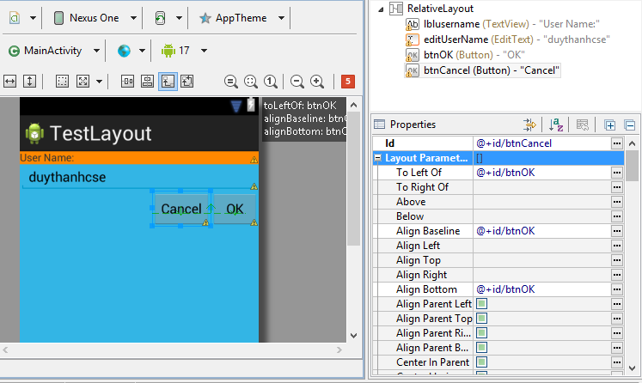
1.6 Common layouts
RelativeLayout: Example
Use the Eclipse ADT Layout Editor for laying out RelativeLayouts

Slide 45
1.6 Common layouts
AbsoluteLayout:
A layout that lets you specify exact locations (x/y coordinates) of its children. Absolute layouts are less flexible and harder to maintain than other types of layouts without absolute positioning.

Slide 46
1.6 Common layouts
Designing Complex Uis
LinearLayout is the most common modeling tool.
Generally, complex UI designs result from the combination of simpler nested boxes that show their inner pieces using a horizontal or vertical orientation.
Summary of Commonly-used Android containers
1.LinearLayout (the box model),
2.RelativeLayout (a rule-based model), and
3.TableLayout (the grid model), along with
4.ScrollView, a container designed to assist with implementing scrolling containers.
5.Other (ListView, GridView, WebView, MapView,…) discussed later

Slide 47
2. Types of event programming
2.1 Onclick in XML
2.2 Inline anonymous listener
2.3 Activity is listener
2.4 Listener in variable
2.5 Explicit Listener Class
2.6 View subclassing

Slide 48
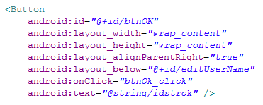
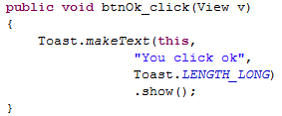
2.1 Onclick in XML
Using onClick view property of view (android:onClick) in xml

Slide 49
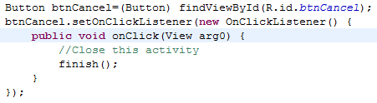
2.2 Inline anonymous listener
•create an anonymous listener
•define and pass it the setOnClickListener functions in the same step

Slide 50
2.3 Activity is listener
•adding an interface to your base class.
–adding “implements Interfacename” to the class declaration

Slide 51
2.4 Listener in variable
•similar to Implements
•don’t add the implementation to class
•hold a reference to the Listener in a variable

Slide 52
2.5 Explicit Listener Class
An explicit class for the listener, but an anonymous (inlined) listener object

Slide 53
2.6 View subclassing

Slide 54
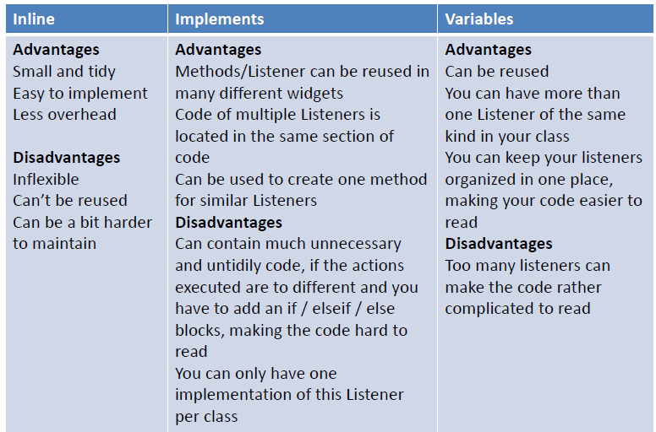
Comparision

Slide 55
Demo
•Simple math calculator
–Inline anonymous class
–Activity as listener
–Variable as listener
•Note
–final keyword
•What does it mean?

Slide 56
3. Toast & Alert Dialog
3.1 Toast notification
3.2 Alert Dialog

Slide 57
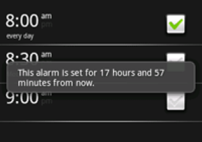
3.1 Toast notification
A message that pops up on the surface of the window.
It only fills the amount of space required for the message.
The notification automatically fades in and out, and does not accept interaction events.
can be created and displayed from an Activity or Service.

Slide 58
3.1 Toast notification
Toast toast=Toast.makeText(StylesActivity.this, "text", Toast.LENGTH_SHORT);
toast.setGravity(Gravity.CENTER, 0, 0);
toast.show();
Short form
Toast.makeText(context, text, duration).show();
Use Application Context or Activity context
2 values for duration: Toast.LENGTH_SHORT to display for a short duration (2 seconds) or Toast.LENGTH_LONG for longer duration (3.5 seconds)
Read more:
http://developer.android.com/guide/topics/ui/notifiers/toasts.html

Slide 59
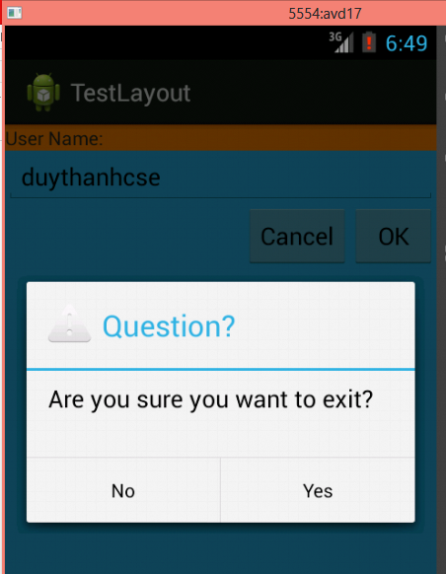
3.2 Alert Dialog
show critical messages to the user
information about our application
Confirm
Yes/No message dialog
Yes/No Long Message Dialog
Pick One from a List Dialog
Pick a number of items from a larger set
Progress Dialog
Single choice from a set of choices dialog
A prompt dialog
Custom dialog

Slide 60
3.2 Alert Dialog
create an instance of AlertDialog.Builder.
activity context
setTitle → Sets the title of the pop-up. Just a String
setMessage → We can add a message. A String
setIcon: passing a Drawable object
R.drawable.icon
setCancelable (true/flase)

Slide 61
3.2 Alert Dialog
setNegativeButton → add a simple button (cancel button)
setPositiveButton → add a simple button. (OK button)
setNeutralButton → button to perform another functionality other than ok or cancel
no restrictions on the use of the three buttons, cause the Alert dialog to dismiss
they can perform the same functionality the difference is just in logical meaning.
setOnCancelListener

Slide 62
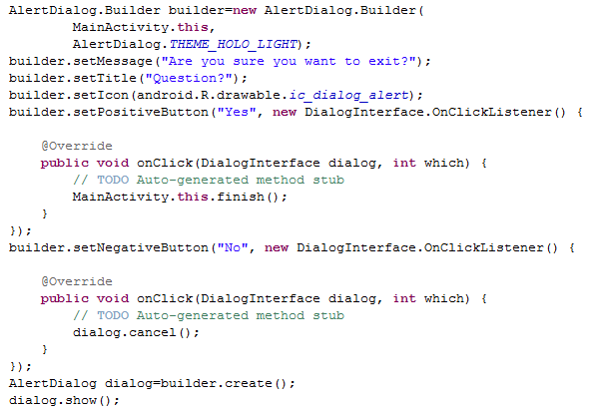
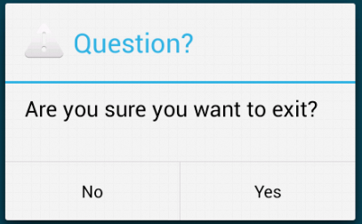
3.2 Alert Dialog
http://developer.android.com/guide/topics/ui/dialogs.html

Slide 63
4. Common controls
4.1 View
4.2 TextView
4.3 EditText
4.4 Button
4.5 Checkbox
4.6 RadioButton
4.7 Image
4.8 ScrollView control

Slide 64
4.1 View
All of the views in a window are arranged in a single tree.
common operations :
1.Set properties
android:textStyle= "bold"
2.Set focus:
To force focus to a specific view, call requestFocus().
3.Set up listeners:
4.Set visibility:
You can hide or show views using setVisibility(int).
To get color hex code: http://www.color-hex.com/
A Detailed List of Widgets:
http://developer.android.com/reference/android/widget/package-summary.html

Slide 65
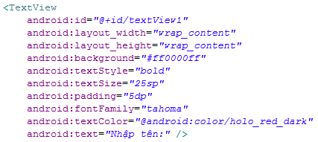
4.2 TextView
A label is called in android a TextView, typically used to display a caption, not editable
http://developer.android.com/reference/android/widget/TextView.html
Some properties

Slide 66
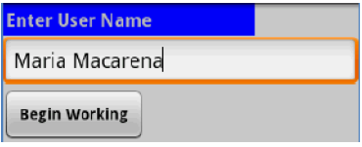
4.3 EditText
The EditText (or textBox) widget is an extension of TextView that allows updates.
The control configures itself to be editable.
Important Java methods are:
EditText txtbox=(EditText) findViewById(R.id.txtUser);
txtBox.setText(“someValue”) and txtBox.getText().toString()
http://developer.android.com/reference/android/widget/EditText.html

Slide 67
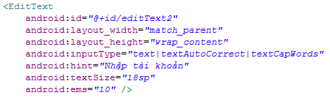
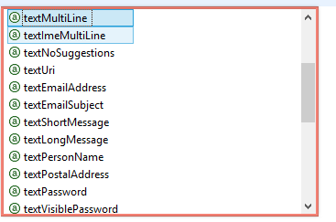
4.3 EditText
TextAutoCorrect: input “teh” ➔”the”
TextCapword: Upper case word

Slide 68
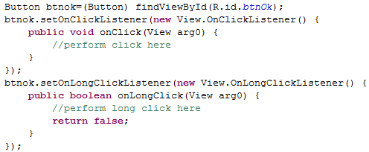
4.4 Button
Button is a subclass of TextView->formatting a Button’s face is similar to the setting of a TextView.

Slide 69
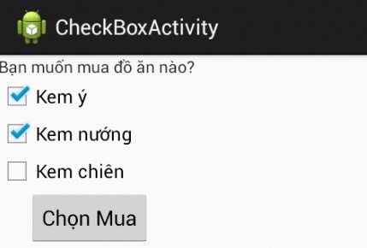
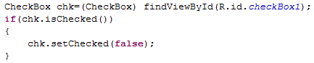
4.5 Checkbox
checkbox is a specific type of two-states button that can be either checked or unchecked.
A example usage of a checkbox inside your activity would be the following:

Slide 70
4.6 RadioButton
A radio button is a two-states button that can be either checked or unchecked.
When the radio button is unchecked, the user can press or click it to check it.
Radio buttons are normally used together in a RadioGroup.
When several radio buttons live inside a radio group, checking one radio button unchecks all the others.
RadioButton inherits from … TextView. Hence, all the standard TextView properties for font face, style, color, etc. are available for controlling the look of radio buttons.
Similarly, you can call isChecked() on a RadioButton to see if it is selected, toggle() to select it, and so on, like you can with a CheckBox.

Slide 71
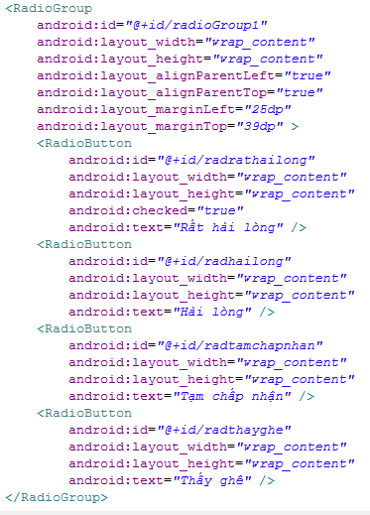
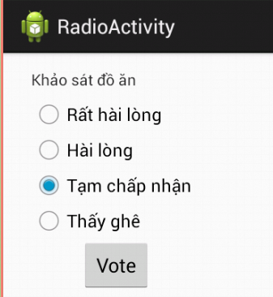
4.6 RadioButton

Slide 72
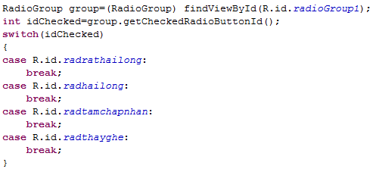
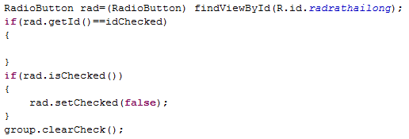
4.6 RadioButton

Slide 73
4.7 Image
ImageView and ImageButton are two Android widgets that allow embedding of images in your applications.
Both are image-based widgets analogue to TextView and Button, respectively.
Each widget takes an android:src or android:background attribute (in an XML layout) to specify what picture to use.
Pictures are usually reference a drawable resource.
ImageButton, is a subclass of ImageView. It adds the standard Button behavior for responding to click events.

Slide 74
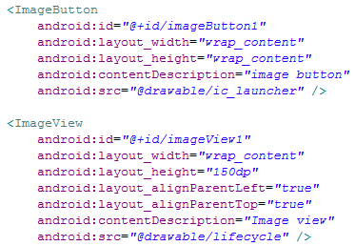
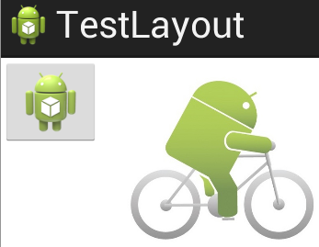
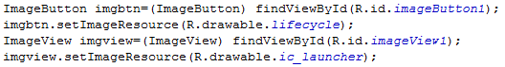
4.7 Image

Slide 75
4.8 ScrollView control
When we have more data than what can be shown on a single screen you may use the ScrollView control.
It provides a sliding or scrolling access to the data. This way the user can only see part of your layout at one time, but the rest is available via scrolling.
This is similar to browsing a large web page that forces the user to scroll up the page to see the bottom part of the form.

Slide 76
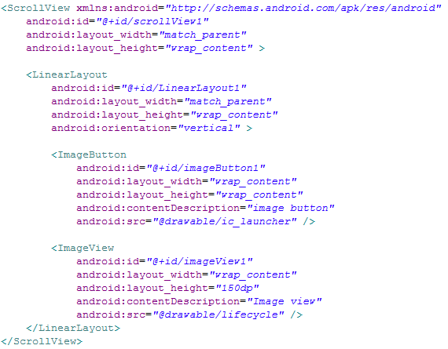
4.8 ScrollView control

Slide 77
5. Advanced controls
5.1 Listview
5.2 Spinner
5.3 SlidingDrawer
5.4 AutocompleteTextView
5.5 Gridview
5.6 Time Selection
5.7 Picture Gallery
5.8 Tab selector
5.9 Menu

Slide 78
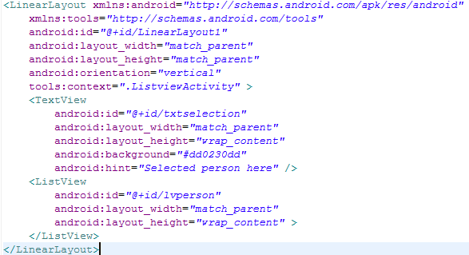
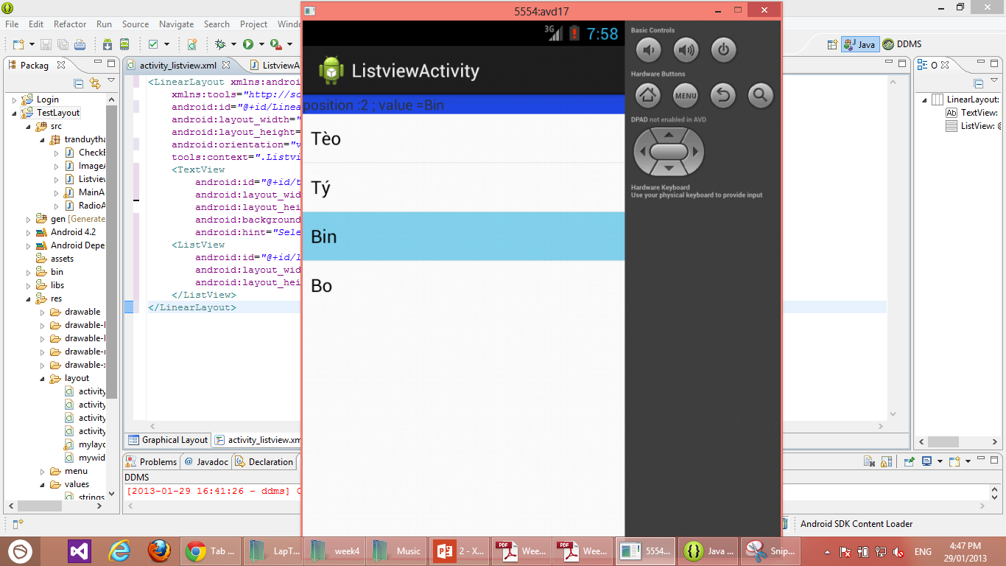
5.1 Listview

Slide 79
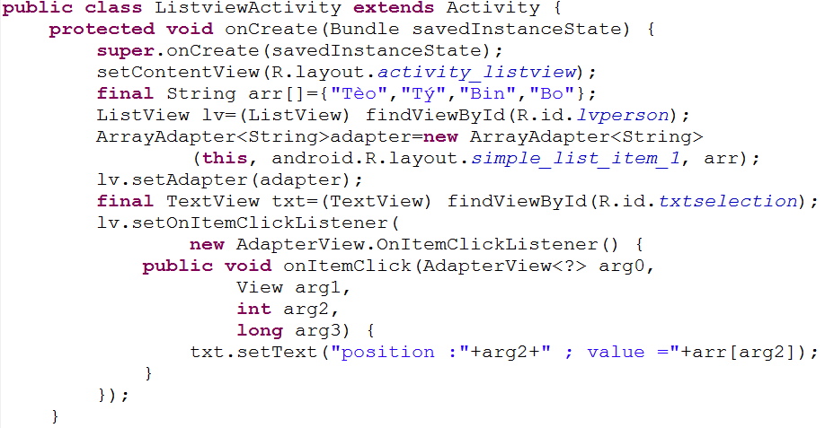
5.1 Listview

Slide 80
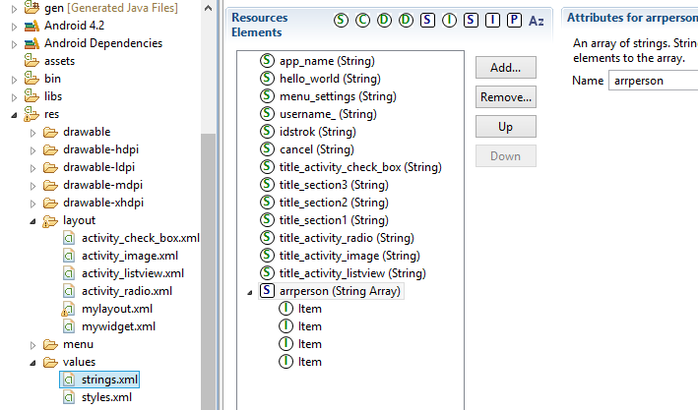
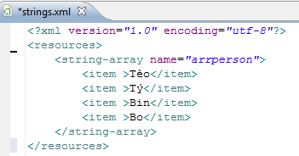
5.1 Listview
Click add button to do…
Using string-array resource

Slide 81
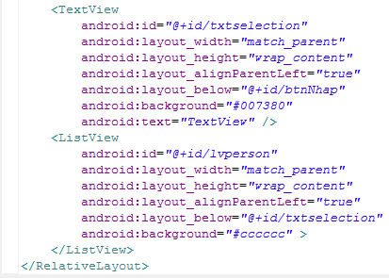
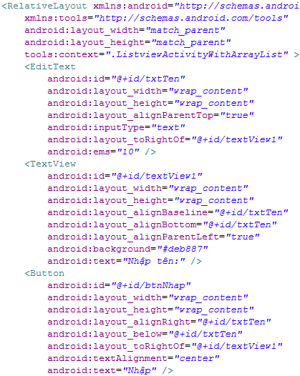
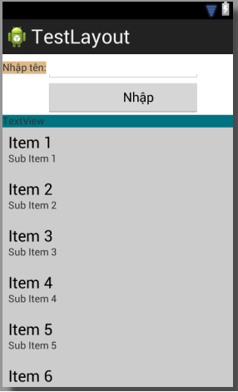
5.1 Listview
Using ArrayList

Slide 82
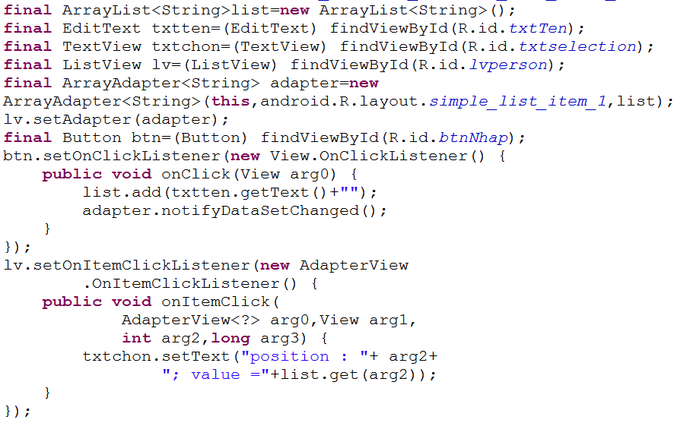
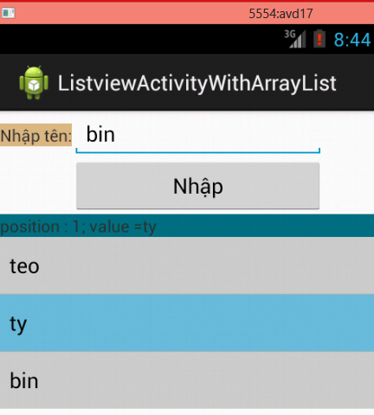
5.1 Listview
Using ArrayList

Slide 83
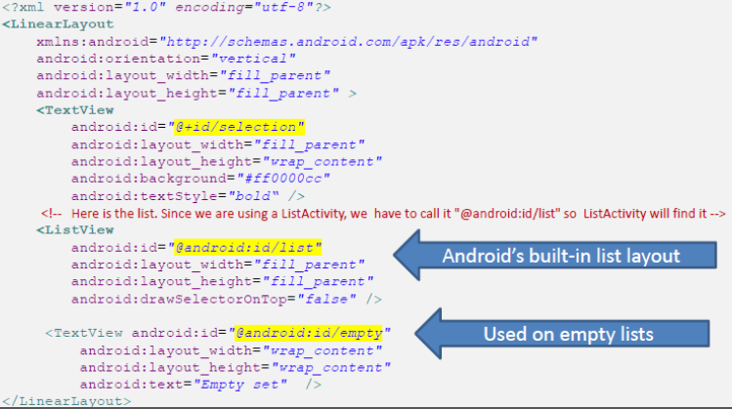
5.1 Listview
Using ListActivity

Slide 84
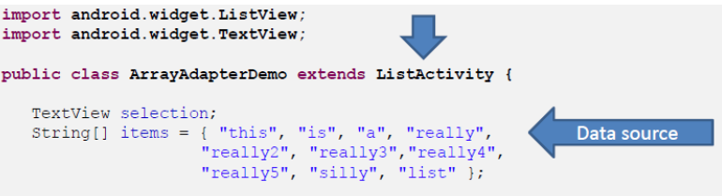
5.1 Listview
Using ListActivity
NOTE: The ListActivity class is implicitly bound to an object identified by @android:id/list

Slide 85
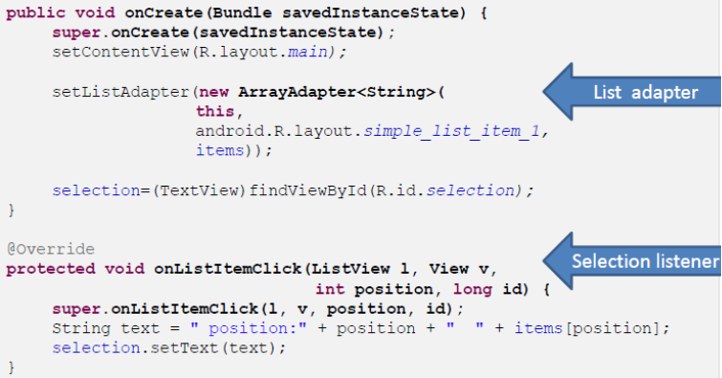
5.1 Listview
Using ListActivity

Slide 86
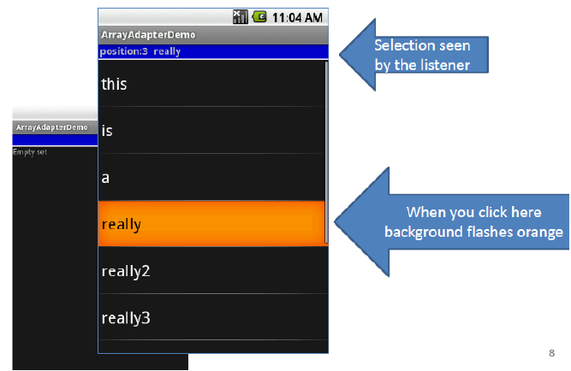
5.1 Listview
Using ListActivity

Slide 87
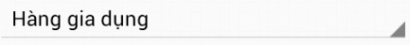
5.2 Spinner
In Android, the Spinner is the equivalent of the drop-down selector.
Spinners have the same functionality of a ListView but take less space.
As with ListView, you provide the adapter for linking data to child views using setAdapter()
Add a listener object to capture selections made from the list with setOnItemSelectedListener().
Use the setDropDownViewResource()method to supply the resource ID of the multi-line selection list view to use.

Slide 88



5.2 Spinner
3. Selected value
1. Click here
2. Selected this option

Slide 89

5.2 Spinner

Slide 90

5.2 Spinner

Slide 91

5.2 Spinner
You can use: android.R.layout.simple_spinner_dropdown_item for setDropdownViewResource

Slide 92

5.2 Spinner
View Arg1: the view that represents the selected item
int Arg2: the position of the selected item.
long Arg3: the id of the selected item.

Slide 93


5.3 SlidingDrawer
This class was deprecated in API level 17.

Slide 94
5.3 SlidingDrawer
This class was deprecated in API level 17.
•Hides content out of the screen and allows the user to drag a handle to bring the content on screen.
•SlidingDrawercan be used vertically or horizontally.
•SlidingDrawer should be used as an overlay inside layouts. This means SlidingDrawer should only be used inside of a FrameLayoutor a RelativeLayout for instance.
•The size of the SlidingDrawer defines how much space the content will occupy once slid out so SlidingDrawer should usually use fill_parent for both its dimensions.

Slide 95
5.3 SlidingDrawer
This class was deprecated in API level 17.

Slide 96

5.3 SlidingDrawer
This class was deprecated in API level 17.

Slide 97

5.3 SlidingDrawer
This class was deprecated in API level 17.
We can use Sliding Menu in https://github.com/jfeinstein10/slidingmenu

Slide 98
5.4 AutocompleteTextView
With auto-completion, as the user types, the text is treated as a prefix filter, comparing the entered text as a prefix against a list of candidates.
Matches are shown in a selection list that, like with Spinner, folds down from the field.
The user can either type out a new entry (e.g., something not in the list) or choose an entry from the list to be the value of the field.
AutoCompleteTextView subclasses EditText, so you can configure all the standard look-and-feel aspects, such as font face and color.
AutoCompleteTextView has a android:completionThreshold property, to indicate the minimum number of characters a user must enter before the list filtering begins.

Slide 99


5.4 AutocompleteTextView
Select this

Slide 100

5.4 AutocompleteTextView
Min 1 char to work

Slide 101

5.4 AutocompleteTextView
Also MultiAutocompleteTextView

Slide 102


5.4 AutocompleteTextView
Also MultiAutocompleteTextView

Slide 103


5.5 Gridview
–GridView is a ViewGroup that displays items in a two-dimensional, scrollable grid.
–The grid items are automatically inserted to the layout using a ListAdapter.

Slide 104
5.5 Gridview
•GridView Some properties used to determine the number of columns and their sizes:
–android:numColumns spells out how many columns there are, or, if you supply a value of auto_fit, Android will compute the number of columns based on available space and the properties listed below.
–android:verticalSpacing and its counterpart android:horizontalSpacing indicate how much whitespace there should be between items in the grid.
–android:columnWidth indicates how many pixels wide each column should be.
–android:stretchMode indicates, for grids with auto_fit for android:numColumns, what should happen for any available space not taken up by columns or spacing .

Slide 105
5.5 Gridview
•Example: Fitting the View
–Suppose the screen is 320pixels wide, and we have
–android:columnWidth set to 100px and
–android:horizontalSpacing set to 5px.
–Three columns would use 310pixels (three columns of 100 pixels and two whitespaces of 5 pixels).
–With android:stretchModes et to columnWidth, the three columns will each expand by 3-4 pixels to use up the remaining 10 pixels.
–With android:stretchMode set to spacingWidth, the two internal whitespaces will each grow by 5 pixels to consume the remaining 10 pixels.

Slide 106


5.5 Gridview

Slide 107

5.5 Gridview

Slide 108



5.6 Time Selection

Slide 109
5.6 Time Selection
•Date
•Android also supports widgets (DatePicker, TimePicker) and dialogs (DatePickerDialog, TimePickerDialog) for helping users enter dates and times.
•The DatePicker and DatePickerDialog allow you to set the starting date for the selection, in the form of a year, month, and day.
•Value of month runs from 0 for January through 11 for December.
•Each widget provides a callback object (OnDateChangedListener or OnDateSetListener) where you are informed of a new date selected by the user.

Slide 110
5.6 Time Selection
•The widgets TimePicker and TimePickerDialog let you:
–1.set the initial time the user can adjust, in the form of an hour(0 through 23) and a minute(0 through 59)
–2.indicate if the selection should be in 12-hour mode (with an AM/PM toggle), or in 24-hour mode.
–3.provide a callback object (OnTimeChangedListeneror OnTimeSetListener) to be notified of when the user has chosen a new time (which is supplied to you in the form of an hour and minute)

Slide 111



5.6 Time Selection

Slide 112

5.6 Time Selection

Slide 113

5.6 Time Selection

Slide 114

5.6 Time Selection

Slide 115

5.7 Picture Gallery
Gallery Widget:
–The Gallery widget provides a set of options depicted as images.
–Image choices are offered on a contiguous horizontal mode, you may scroll across the image-set.
C
L
I
C
k

Slide 116

5.7 Picture Gallery

Slide 117

5.7 Picture Gallery

Slide 118

5.7 Picture Gallery

Slide 119
5.7 Picture Gallery
GridView (again…)
–A –perhaps--more interesting version of the GridView control uses images instead of text.
–The programmer must supply an ImageAdapter to indicate what to do when an individual image is selected/clicked.
–The following example illustrates how to use this control.

Slide 120


5.7 Picture Gallery

Slide 121


5.7 Picture Gallery
Solo_picture.xml

Slide 122

5.7 Picture Gallery

Slide 123

5.7 Picture Gallery

Slide 124

5.7 Picture Gallery

Slide 125


5.8 Tab selector
•Android UIs should be kept simple at all costs.
•When many pieces of information must be displayed in a single app, the Tab Widget could be used to make the user aware of the pieces but show only a portion at the time.

Slide 126
5.8 Tab selector
•There are a few widgets and containers you need to use in order to set up a tabbed portion of a view:
–1. TabHost is the main container for the tab buttons and tab contents
–2. TabWidget implements the row of tab buttons, which contain text labels and optionally contain icons
–3. FrameLayout is the container for the tab contents

Slide 127
5.8 Tab selector

Slide 128


5.8 Tab selector
Include layout here

Slide 129



5.8 Tab selector
Layout_login.xml

Slide 130

5.8 Tab selector

Slide 131
5.9 Menu-Context menu
•Menus usually increase the functionality of an app by providing additional operations on a small overlapping panel. Android provides two types of menu known as: options menu and context menu.
–The options menu is triggered by pressing the hardware Menu button on the device, while
–the context menu is raised by a tap-and-hold on the widget associated to the menu.

Slide 132
5.9 Menu-Context menu
•Option and Context Menus may include:
–1.Text
–2. Icons
–3. Radio Buttons
–4. Check Boxes
–5. Sub-menus
–6. Short-cut keys
Unlike the options menu (which is only built once per activity), context menus are discarded once they are used or dismissed.

Slide 133


5.9 Menu-Context menu

Slide 134


5.9 Menu-Context menu
Menu activity_main.xml

Slide 135


5.9 Menu-Context menu
Long press to show context menu

Slide 136


5.9 Menu-Context menu

Slide 137

5.9 Menu-Context menu

Slide 138

5.9 Menu-Context menu

Slide 139


5.9 Menu-Context menu

Slide 140

5.9 Menu-Context menu

Slide 141
6. Custom layout
•Customized Lists
–Android provides predefined row layouts for displaying simple lists. However, you may want more control in situations such as:
•1.Not every row uses the same layout (e.g., some have one line of text, others have two)
•2.You need to configure the widgets in the rows (e.g., different icons for different cases)
•In those cases, the better option is to create your own subclass of your desired Adapter.

Slide 142
6. Custom layout
•Customized Lists
•In order to subclass your desired Adapter, you need to
–1.override getView(), and
–2.construct your rows yourself.
•The getView()method is responsible for returning a View, representing the row for the supplied position of the adapter.
•Example: Modify getView(), so we can have different icons for different rows in a list –in this case, one icon for short words and one for long words.

Slide 143


6. Custom layout

Slide 144

6. Custom layout

Slide 145

6. Custom layout

Slide 146

6. Custom layout

Slide 147
6. Custom layout
•Customized Lists –LayoutInflater()
–In this case, “inflation” means the act of converting an XML layout specification into the actual tree of View objects the XML represents.
–An ArrayAdapter requires three arguments: current context, layout to show the output row, source data items (data to place in the rows).
–The overridden getView() method inflates the layout by custom allocating icons and text taken from data source in the user designed row. Once assembled the View (row) is returned.

Slide 148
7. Webkit
7.1 Webkit Browser
7.2 Permission to access internet
7.3 Browser commands
7.4 HTML + Javascript + Android
7.5 Demo find location

Slide 149
7.1 Webkit Browser
•In Android you can embed the built-in Web browser as a widget in your own activities, for displaying HTML material or perform Internet browsing.
•The Android browser is based on WebKit, the same engine that powers Apple's Safari Web browser.
•Android uses the WebView widget to host the browser’s pages
•Applications using the WebView component must request INTERNET permission.

Slide 150
7.1 Webkit Browser
•The browser will access the Internet through whatever means are available to that specific device at the present time (WiFi, cellular network, Bluetooth-tethered phone, etc.). The WebKit rendering engine used to display web pages includes methods to
–navigate forward and backward through a history,
–zoom in and out,
–perform text searches,
–load data
–stop loading and
–more.

Slide 151



7.2 Permission to access internet
•In order for your Activity to access the Internet and load web pages in a WebView, you must add the INTERNET permissions to your Android Manifest file:
<uses-permission android:name="android.permission.INTERNET" />
•This must be a child of the <manifest> element.

Slide 152


Example:

Slide 153
Example:
•You may directly provide the HTML to be displayed by the browser (such as a user manual for instance, directions on a map, or the actual app interface created as HTML instead of using the native Android UI framework).
browser.loadData("<html><body>Hello, world! </body> </html>", "text/html", "UTF-8");

Slide 154



Example:
You may include simple static Google Maps
https://maps.google.com/

Slide 155
7.3 Browser commands
•There is no navigation toolbar with the WebView widget (saving space). You could supply the UI –such as a Menu– to execute the following operations:
–reload() to refresh the currently-viewed Web page
–goBack() to go back one step in the browser history, and canGoBack() to determine if there is any history to trace back
–goForward() to go forward one step in the browser history, and canGoForward() to determine if there is any history to go forward to
–goBackOrForward() to go backwards or forwards in the browser history, where negative/positive numbers represent a count of steps to go
–canGoBackOrForward() to see if the browser can go backwards or forwards the stated number of steps (following the same positive/negative convention as goBackOrForward())
–clearCache() to clear the browser resource cache and clearHistory() to clear the browsing history

Slide 156
7.3 Browser commands
•browser.goBack();
•browser.goForward();
•browser.goBackOrForward(-2);
•browser.goBackOrForward(+2);
•browser.canGoBack();
•browser.canGoForward();
•browser.canGoBackOrForward(-2);
•browser.canGoBackOrForward(+2);
•browser.clearCache(true);
•browser.clearHistory();
•browser.stopLoading();
Please visit the link below to see detail public method for webview:
http://developer.android.com/reference/android/webkit/WebView.html

Slide 157
7.4 HTML + Javascript + Android
•If you set the URL to a site whose pages depend on Javascript you may see an empty, white screen.
•By default Javascript is turned off in WebView widgets.
•If you want to enable Javascript, call :
myWebView.setSettings().setJavaScriptEnabled(true);
•on the WebView instance.

Slide 158
7.4 HTML + Javascript + Android
•public void addJavascriptInterface ( Object obj, String interfaceName )
–Use this function to bind an object to JavaScript so that the methods can be accessed from JavaScript.
•IMPORTANT:
–Using addJavascriptInterface() allows JavaScript to control your application.
–This can be a very useful feature or a dangerous security issue.
–Do not use addJavascriptInterface() unless all of the HTML in this WebView was written by you.

Slide 159
7.4 HTML + Javascript + Android
•Advantages offered by Android Development
–Access to native services on the device, including location services
–Placement in the Android Market
–Rapid development using the Android SDK and Eclipse.
•Advantages offered by Google Maps API
–Application exists in a server not inside a device.
–Rapid versioning, removing the requirement for your users to download and install constant updates.
–More frequent feature additions and bug fixes from Google.
–Cross-platform compatibility: Using the Maps API allows you to create a single map that runs on multiple platforms.
–Designed to load fast on Android and iPhone devices.

Slide 160
7.4 HTML + Javascript + Android
•WebView2: Passing Objects between Android and JS (goal: create interconnectivity)
•WebView3: Mapping a fixed location using Google Maps V3 (Pure HTML + JS, just update the server -no need to upgrade ALL devices carrying the application, portability, homogeneous design)
•WebView4: Passing a real location object to JS – draw a map centered at given location (mapping current location, combines two above).

Slide 161

7.5 Demo find location
Exchanging objects between Android & JS

Slide 162


7.5 Demo find location
Using Microsoft Expression Web to design location UI, save file to assets folder with name mylocation.html

Slide 163

7.5 Demo find location
mylocation.html

Slide 164


7.5 Demo find location
mylocation.html

Slide 165

7.5 Demo find location

Slide 166

7.5 Demo find location

Slide 167

7.5 Demo find location

Slide 168
8. Intent
8.1 Explicit Intent
8.2 Implicit Intent
8.3 Getting results from Intents

Slide 169
8. Intent
Intents are used as a message-passing mechanism that works both within your application, and between applications. Intents can be used to:
➤ Declare your intention that an Activity or Service be started to perform an action, usually with (or on) a particular piece of data
➤ Broadcast that an event (or action) has occurred
➤ Explicitly start a particular Service or Activity

Slide 170
8.1 Explicit Intent
- The most common use of Intents is to bind your application components. Intents are used to start, and transition between, Activities.
- To open an Activity, call startActivity, passing in an Intent as shown in the following snippet:
startActivity(myIntent);
- The startActivity method finds and starts the single Activity that best matches your Intent.
When you use startActivity your application won’t receive any notification when the newly launched Activity finishes.
- To track feedback from the opened screen use the startActivityForResult (Will learn later)

Slide 171




8.1 Explicit Intent
btnOpenChildActivity
btnBacktoMainActivity

Slide 172

8.1 Explicit Intent

Slide 173

8.1 Explicit Intent

Slide 174

8.1 Explicit Intent
Config Manifest

Slide 175

8.1 Explicit Intent
Bundle
An activity usually presents a single visual user interface from which a number of actions could be performed.
Moving from one activity to another is accomplished by having the current activity start the next one through so called intents
Activity 2
Intent
{action + data}
Activity 1
startActivity
(Activity 2)
Package from activity 1

Slide 176

8.1 Explicit Intent
Bundle
The Android Bundle container is a simple mechanism used to pass data between activities.
A Bundle is a type‐safe collection of <name, value> pairs.
There is a set of putXXX and getXXX methods to store and retrieve (single and array) values of primitive data types from/to the bundles. For example
Put
get

Slide 177


8.1 Explicit Intent
Bundling Complex Objects
Bundle

Slide 178


8.1 Explicit Intent
Example using Intent with Bundle
ResultActivity
MainActivity
txtketqua
btnBack
txta
txtb
btnketqua
To learn more Bundle please visit the link below:
http://developer.android.com/reference/android/os/Bundle.html

Slide 179

8.1 Explicit Intent

Slide 180

8.1 Explicit Intent
Return the intent that started this activity.

Slide 181
8.2 Implicit Intent
An implicit Intent is a mechanism that lets anonymous application components service action requests. That means you can ask the system to launch an Activity that can perform a given action without knowing which application, or Activity, will do so.
Please visit the link below to see detail:
http://developer.android.com/reference/android/content/Intent.html

Slide 182




8.2 Implicit Intent

Slide 183

8.2 Implicit Intent

Slide 184
8.2 Implicit Intent
Native Android Actions:
➤ ACTION_ANSWER Opens an Activity that handles incoming calls. Currently this is handled by the native in-call screen.
➤ ACTION_CALL Brings up a phone dialer and immediately initiates a call using the number supplied in the Intent URI. Generally it’s considered better form to use ACTION_DIAL ifpossible.
➤ ACTION_DELETE Starts an Activity that lets you delete the data specified at the Intent’s data URI.
➤ ACTION_DIAL Brings up a dialer application with the number to dial pre-populated from the Intent URI. By default this is handled by the native Android phone dialer. The dialer can normalize most number schemas: for example, tel:555-1234 and tel:(212) 555 1212 are both valid numbers.
➤ ACTION_EDIT Requests an Activity that can edit the data at the specified Intent URI.
➤ ACTION_INSERT Opens an Activity capable of inserting new items into the Cursor specified in the Intent URI. When called as a sub-Activity it should return a URI to the newly inserted item.

Slide 185
8.2 Implicit Intent
Native Android Actions:
➤ ACTION_PICK Launches a sub-Activity that lets you pick an item from the Content Provider specified by the Intent URI. When closed it should return a URI to the item that was picked. The Activity launched depends on the data being picked: for example, passing
content://contacts/people will invoke the native contacts list.
➤ ACTION_SEARCH Launches the Activity used for performing a search. Supply the search term as a string in the Intent’s extras using the SearchManager.QUERY key.
➤ ACTION_SENDTO Launches an Activity to send a message to the contact specified by the Intent URI.
➤ ACTION_SEND Launches an Activity that sends the data specified in the Intent. The recipient contact needs to be selected by the resolved Activity. Use setType to set the MIME type of the transmitted data.

Slide 186
8.2 Implicit Intent
Native Android Actions:
➤ ACTION_VIEW The most common generic action. View asks that the data supplied in the Intent’s URI be viewed in the most reasonable manner. Different applications will handle view requests depending on the URI schema of the data supplied. Natively http: addresses will open in the browser, tel: addresses will open the dialer to call the number, geo: addresses will be displayed in the Google Maps application, and contact content will be displayed in the contact manager.
➤ ACTION_WEB_SEARCH Opens an Activity that performs a web search based on the text supplied in the Intent URI (typically the browser).

Slide 187
8.3 Getting results from Intents
The startActivity(Intent) method is used to start a new activity, which will be placed at the top of the activity stack. The caller however continues to execute in its own thread.
Sometimes you want to get a result back from the called sub‐activity when it ends.
For example, you may start an activity that let the user pick a person from a list of contacts; when it ends, it returns the person that was selected.

Slide 188
8.3 Getting results from Intents

Slide 189
8.3 Getting results from Intents
Before an invoked activity exits, it can call setResult (resultCode) to return a termination signal back to its parent.
It is convenient to supply a result code, which can be the standard results Activity.RESULT_CANCELED, Activity.RESULT_OK, or any custom values.
All of this information can be capture back on the parent's onActivityResult (int requestCodeID, int resultCode, Intent data)
If a child activity fails for any reason (such as crashing), the parent activity will receive a result with the code RESULT_CANCELED.

Slide 190
8.3 Getting results from Intents

Slide 191



8.3 Getting results from Intents
Example
1) Load list person on the ListView
3) Click Lưu Button
2) Long Item Press on the ListView and choose this menu item

Slide 192



8.3 Getting results from Intents
1) Load list person on the ListView
3) Click Lưu Button
2) Long Item Press on the ListView and choose this menu item

Slide 193



8.3 Getting results from Intents
1) Load list person on the ListView
3) Click Co Button
2) Long Item Press on “ty Be’o” item on the ListView and choose this menu item

Slide 194

8.3 Getting results from Intents
We create a new Project with name LearnActivityForResult
This project has 3 Activity, each Activity will have 1 Layout (see the picture)
One Person Serializable class. This object will use to send from MainActivity to another sub activity and vice versa
The contextmenu

Slide 195

8.3 Getting results from Intents
The Person Serializable
This Object use to send from Activity A to another Activity B
And show on the ListView in the MainActivity

Slide 196

8.3 Getting results from Intents
The mycontextmenu XML

Slide 197

8.3 Getting results from Intents
The MainActivity XML
Person object

Slide 198

8.3 Getting results from Intents
The MainActivity coding
For Requestcode
For Resultcode
Track the Item clicked
Make contextmenu

Slide 199

8.3 Getting results from Intents
The MainActivity coding

Slide 200

8.3 Getting results from Intents
The MainActivity coding

Slide 201

8.3 Getting results from Intents
The MainActivity coding
This method use to get data from sub activity callback

Slide 202




8.3 Getting results from Intents
The New Activity XML
Please config as the same in the Manifest xml
Use the TableLayout to design for this Activity, here are the ids for each item in this Activity:

Slide 203

8.3 Getting results from Intents
The New Activity coding

Slide 204

8.3 Getting results from Intents
The Edit Activity XML
Please config as the same in the Manifest xml
Use the TableLayout to design for this Activity, here are the ids for each item in this Activity:

Slide 205

8.3 Getting results from Intents
The Edit Activity coding

Slide 206
9. Touch & Multi touch
9.1 Setup a touch listener
9.2 The MotionEvent object
9.3 Handling Multiple Touches
9.4 Demo Multi touch application

Slide 207


9.1 Setup a touch listener
Touch events can be intercepted by a view object through the registration of an onTouchListener event listener and the implementation of the corresponding onTouch() callback method.

Slide 208
9.2 The MotionEvent object
The MotionEvent object passed through to the onTouch() callback method is the key to obtaining information about the event. Information contained within the object includes the location of the touch within the view and the type of action performed. The MotionEvent object is also the key to handling multiple touches.
An important aspect of touch event handling involves being able to identify the type of action performed by the user. The type of action associated with an event can be obtained by making a call to the getActionMasked() method of the MotionEvent object which was passed through to the onTouch() callback method.

Slide 209

9.2 The MotionEvent object
When the first touch on a view occurs, the MotionEvent object will contain an action type of ACTION_DOWN together with the coordinates of the touch. When that touch is lifted from the screen an ACTION_UP event is generated. Any motion of the touch between the ACTION_DOWN and ACTION_UP events will be represented by ACTION_MOVE events.

Slide 210

9.3 Handling Multiple Touches
When more than one touch is performed simultaneously on a view, the touches are referred to as pointers. In a multi-touch scenario, pointers begin and end with event actions of type ACTION_POINTER_UP and ACTION_POINTER_DOWN respectively. In order to identify the index of the pointer that triggered the event, the getActionIndex() callback method of the MotionEvent object must be called.

Slide 211

9.4 Demo Multi touch application

Slide 212

9.4 Demo Multi touch application

Slide 213
10. Multi language in Android
10.1 Why multi language?
10.2 Setup multi language

Slide 214

10.1 Why multi language?
Everyone on over the world use the cell phone with different language (maybe?). So your application should support Multilanguage to best sell. Right?
The focus is the English language or Chinese language or Vietnamese language or combodia…?
I think that you should support Multilanguage, and you?
Điện thoại cháu toàn tiếng Campuchia, bà hok config được

Slide 215

10.2 Setup multi language
Some country code, please visit this link:
http://developer.android.com/reference/java/util/Locale.html
Choose the language in the configuration
It will auto append the country code

Slide 216




10.2 Setup multi language

Slide 217

10.2 Setup multi language
The code above will auto choose exactly the language to show on the Listview

Slide 218




10.2 Setup multi language
Choose different language to see data on the Listview

Slide 219
Exercise

Slide 220


END

